Slide 1

CS 533 INTRO TO DATA SCIENCE
Michael Ekstrand

Slide 2
MODELS AND DEPTH

Slide 3

Learning Outcomes
Introduce models beyond linear and logistic models
Introduce the idea of a model output as a feature
Photo by Tim Mossholder on Unsplash

Slide 4
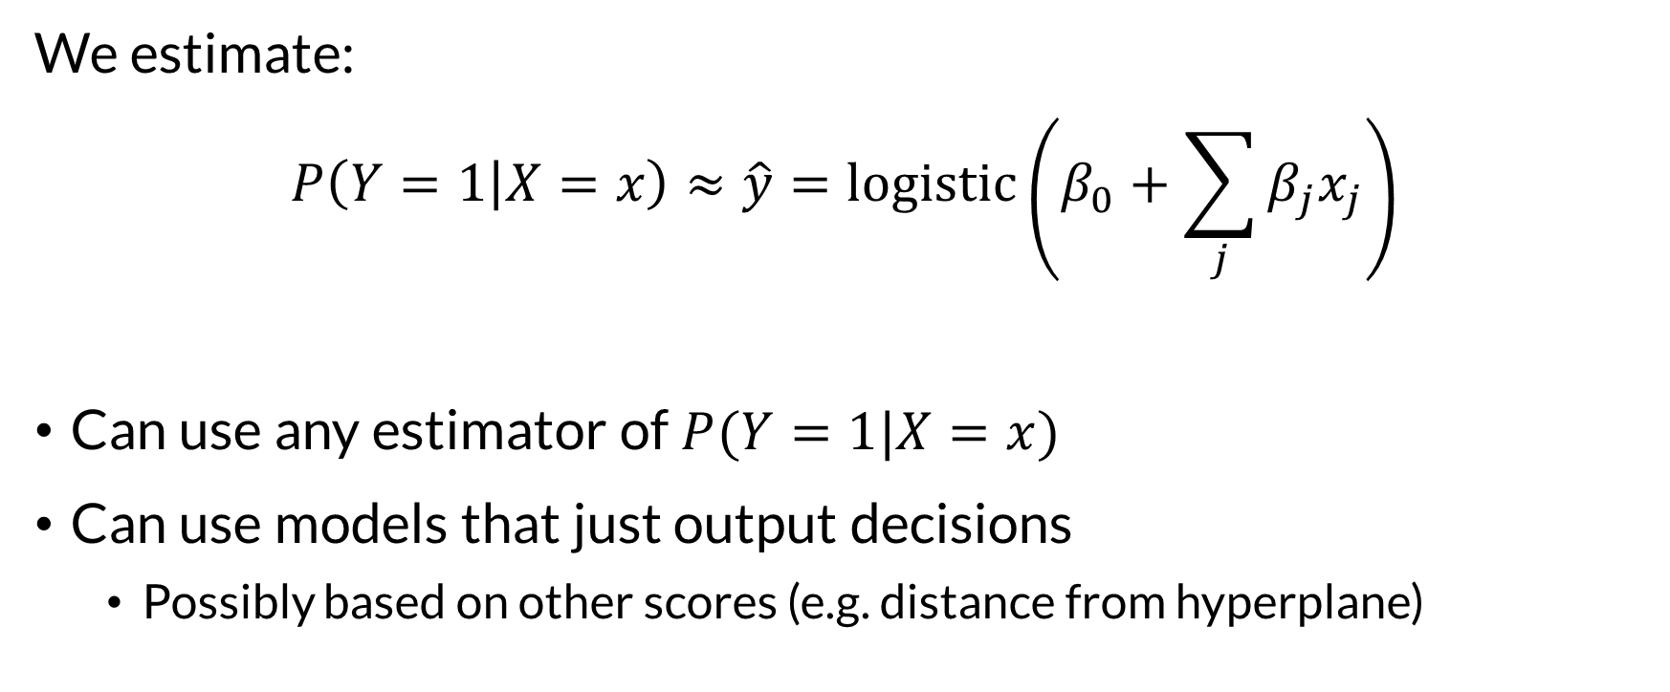
More Models
We estimate:
$$P\left(Y=1 | X=x\right)≈\hat{y}=logistic\left(β_{0}+\sum_{j}{β_{j}x_{j}}\right)$$
Can use any estimator of $P(Y=1|X=x)$
Can use models that just output decisions
Possibly based on other scores (e.g. distance from hyperplane)

Slide 5
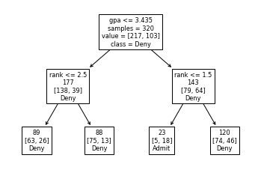

Decision Tree
Tree of nodes
Each node is a decision point
Result when you reach the bottom
Can learn complex interaction effects on their own

Slide 6
Random Forest
Decision trees can have high variance – they can memorize a lot of the model
Random forest:
Take (partial) bootstrap samples of the training data
Fit decision trees
Predict by taking vote from trees

Slide 7
Models as Features
Feature outputs don’t have to come directly from data
Transformation models (e.g. principal component analysis)
Prediction models for other tasks
Example: LinkedIn job ad recommender
Logistic regression
Features from text, job description, user, etc.
One feature: transition probability estimate

Slide 8
Many Models
Linear (GLM, GAM, etc.)
Support vector machines
Naïve Bayes classifiers (we’ll see those later)
Neural nets
Often play the logistic regression game – logit function to convert model scores to probabilities

Slide 9
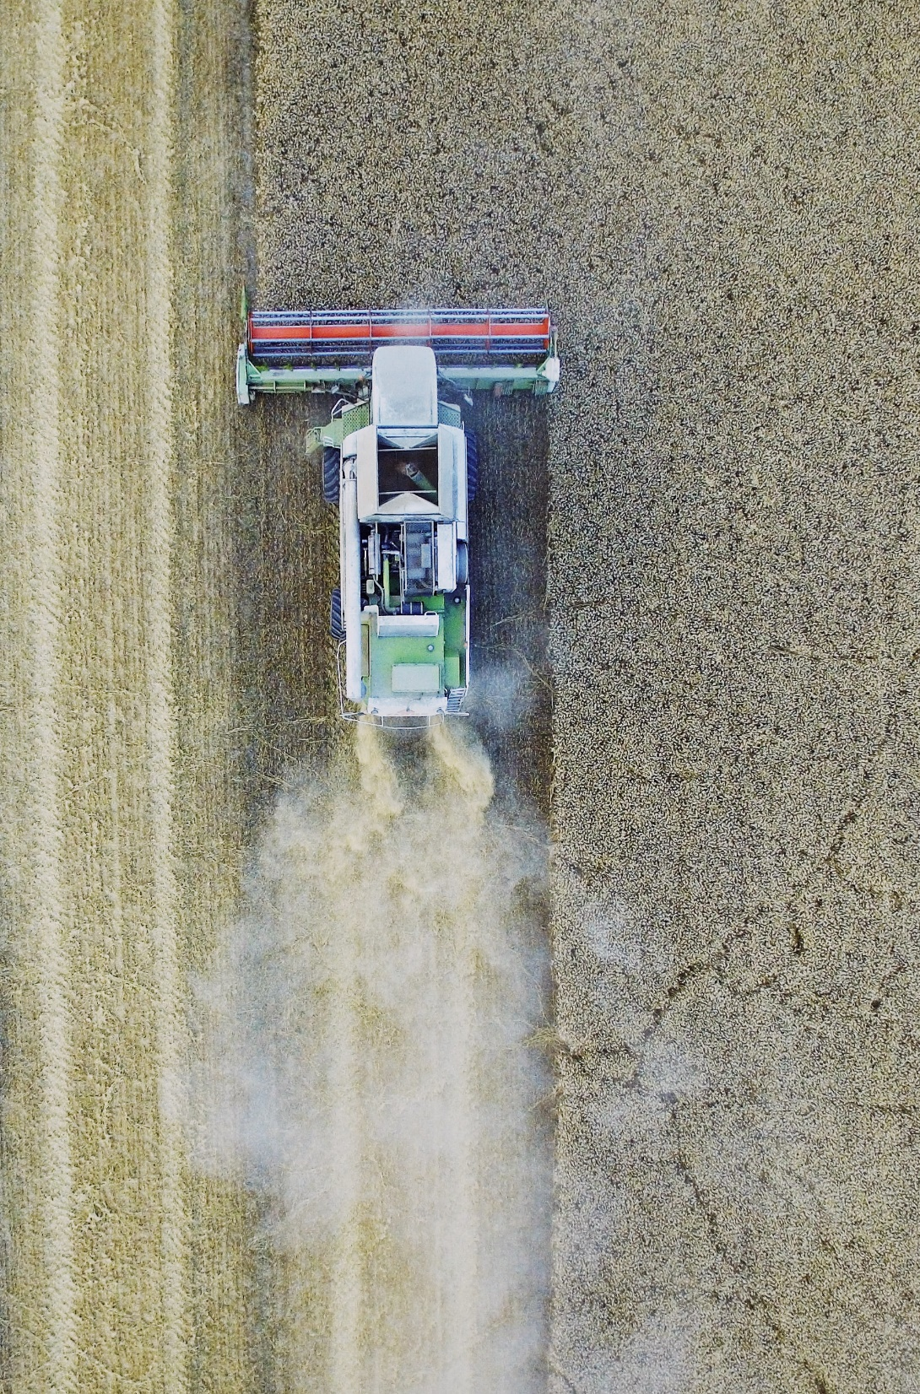
Wrapping Up
There are many models for classification (and regression).
Model outputs can also be features for other (often linear) models.
Photo by Michal Janek on Unsplash

